Slide 1
PRODUCT PROCESSING SYSTEM
Submitted By:
Anjali Rani
Ashu Saini
Rahul Sharma
Pravesh Sharma
Prajwal Kumar
Vidhi Choudhary
Under the Guidance of : Debashish Sir

Slide 2
PROJECT INTRODUCTION
This project will consist of creating the tool for automated Order, Purchase, Sale. This project will fulfill the requirement of inventory and ledger system. It will generate the reports about inventory and ledger to control inventory flow and party ledger. It will enable party to setup order, and administrator module will enable to approve or reject the request, and maintain various lists of shop category.
The main goal of Order Management System is to ensure consistent availability of supplies for consumers. Thus, Order Management System is directed toward owners of small to large stores and stock managers who are responsible of maintaining sufficient goods on hand in a retail or manufacturing business

Slide 3
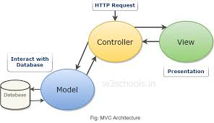
APPROACH USE IN PROJECT :MVC

Slide 4
(.) FRONT END TECHNOLOGY => HTML , CSS , JAVASCRIPT
TECHNOLOGY USE IN PROJECT
(.) BACK END TECHNOLOGY
=> JAVA , HIBERNATE

Slide 5

Functional Requirements:
The structure of the system can be divided into three main logical components. The first component must provide some form of Inventory management, allowing the Store/Shop to control what can be ordered by customers. The second component is the Ordering system and provides the functionality for customers to place their order and supply all necessary details .
As can be seen in the above system model diagramed, each of the three system components essentially provides a layer of isolation between the end user and the database .
Customer
Ordering System
Database
Ordering Retrieval
Store/Shop Employee

Slide 6
The Ordering System
Users of the ordering system, namely Store/Shop customers, must be provided the following functionality:
Create an account.
Manage their account.
Log in to the system.
Customize options for a selected product.
Add a product to their current order.
Remove a product/remove all products from their current order.

Slide 7
Inventory Management System
The Inventory management system will be available only to Store/Shop employees and will, as the name suggests, allow them to manage the Inventory that is displayed to users of the ordering system. The functions afforded by the Inventory management system provide user with the ability to, using a graphical interface:
Add a new/delete supplier to/from the Inventory.
Add a new/delete product category to/from the Inventory.
Add a new/delete product to/from the Inventory.
Add a new/delete option for a given product.
Update price for a given product.
Update default options for a given product.
Update additional information (description, photo, etc.) for a given product.

Slide 8
Order Retrieval System
Of the three components, the order retrieval system is functionally the simplest. Like the Inventory management system, it is designed to be used only by Store/Shop employees, and provides the following functions:
Retrieve new orders from the database.
Display the orders in an easily readable, graphical way.
Mark an order as having been processed and remove it from the active order list

Slide 9
METHODOLOGY USE
Waterfall Model
Spiral Model
Combination of waterfall and spiral model

Slide 10
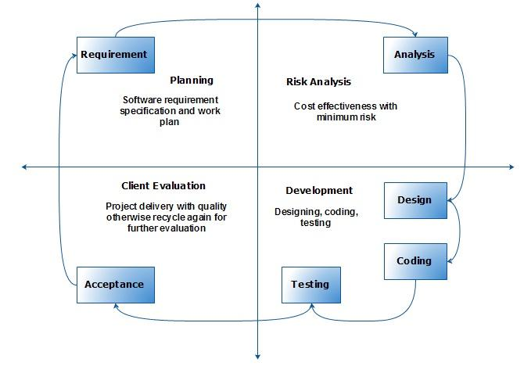
Combination of waterfall and spiral model :

Slide 11
NOW ITS TIME FOR DEMO
Lets Proceed !!!

Slide 12


